Slide 1


Defining Ecological Hydrology
New Orleans District COE – Lunch and Learn
New Orleans, LA
October 20, 2022
Dr. Billy E. Johnson (Presenter), Dr. Todd E. Steissberg, Mr. Isaac J. Mudge, Dr. Zhonglong Zhang

Slide 2
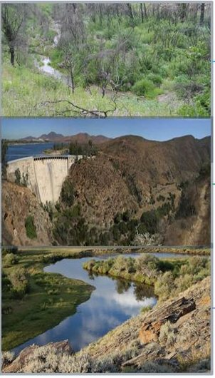
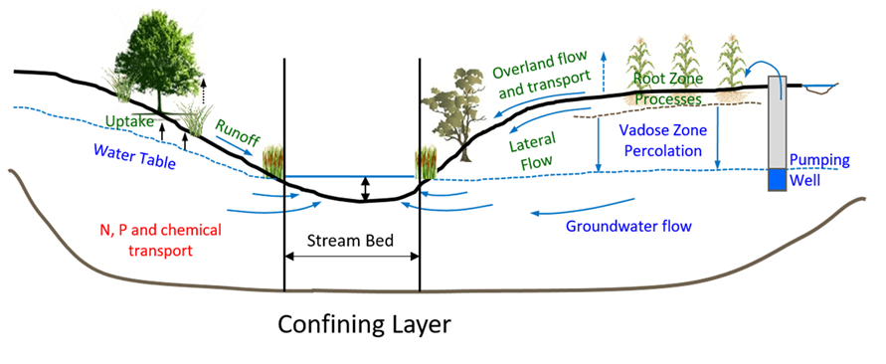
Ecological Hydrology (EcoHydrology)
EcoHydrology is an interdisciplinary scientific field studying the interactions between water and ecological systems. It is considered a sub discipline of hydrology, with an ecological focus.
These interactions may take place within water bodies, such as rivers and lakes, or on land, in forests, deserts, and other terrestrial ecosystems.
Areas of research in EcoHydrology include transpiration and plant water use, adaption of organisms to their water environment, influence of vegetation and benthic plants on stream flow and function, and feedbacks between ecological processes, the soil carbon sponge and the hydrological cycle.

Slide 3
Ecological Hydrology (EcoHydrology)
Principles
The general assumptions of ecological hydrology is to decrease ecosystem degradation using concepts that integrate terrestrial and aquatic processes across scales.
The principles of EcoHydrology are expressed in three sequential components: 1) Hydrological (Framework); 2) Ecological (Target); and 3) Ecological Engineering (Method).

Slide 4
Ecological Hydrology (EcoHydrology)
Hydrological (Framework):
The quantification of the hydrological cycle of a basin, should be a template for functional integration of hydrological and biological processes.
This perspective includes issue of scale, water and temperature dynamics, and hierarchical interactions between biotic and abiotic factors.

Slide 5


Ecological Hydrology (EcoHydrology)
Hydrological (Framework):
The so-called 'two halves' of an ecosystem, biotic and abiotic factors work together to ensure a balanced, vibrant and thriving natural environment. Biotic and abiotic factors are what make up our surrounding natural world.
Biotic factors are living things within an ecosystem. These include humans, plants, fungi, animals and microorganisms including bacteria.
Abiotic factors on the other hand, are non-living components of an ecosystem such as water, temperature, sunlight, nutrients, soil and the atmosphere itself.

Slide 6
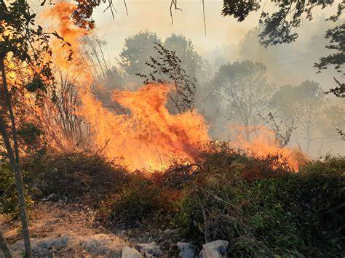
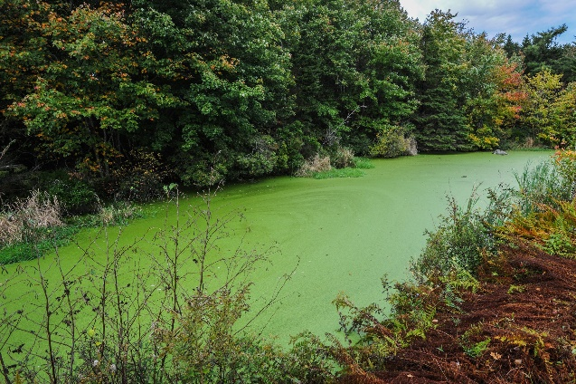
Ecological Hydrology (EcoHydrology)
Ecological (Target):
The integrated processes at river basin scale can be steered in such a way as to enhance the basin's carrying capacity and its ecosystem services.
This component deals with aspects of ecosystem resilience and resistance.
Ecosystem resistance is the ability of a system to avoid change – the capacity to stay in the same state in the face of perturbation (e.g., fire, unusual frost or drought, plowing, eutrophication).
Ecosystem resilience is the rate at which a system returns to its former state after being displaced from it by a perturbation.

Slide 7
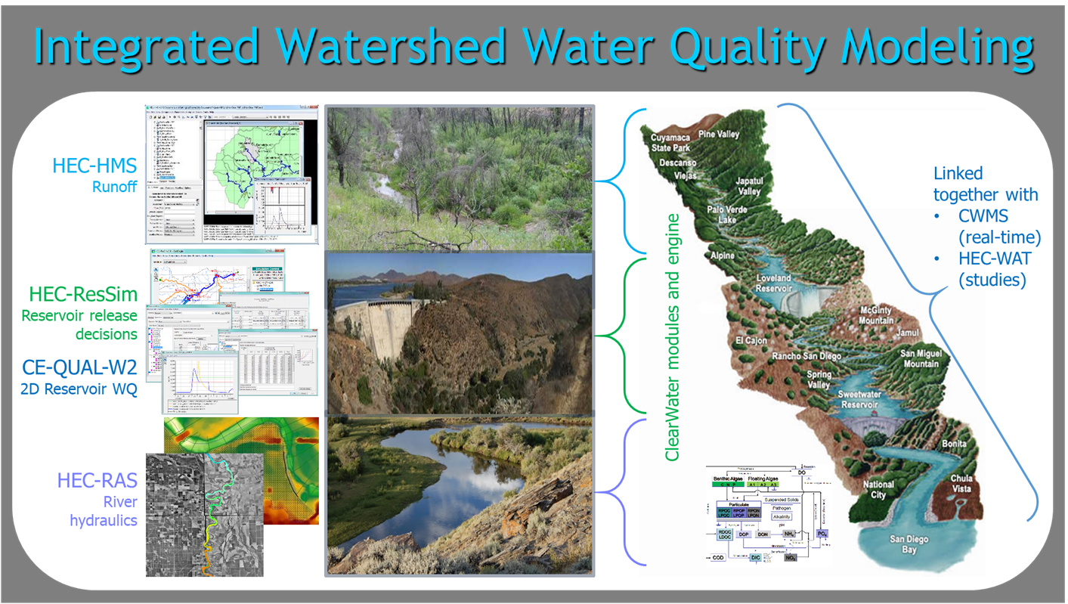
Ecological Hydrology (EcoHydrology)
Ecological Engineering (Method):
The regulation of hydrological and ecological processes, based on an integrative system approach, is thus a new tool for Integrated Water Basin Management.
This method integrates the hydrological framework and ecological targets to improve water quality and ecosystem services, using engineering methods such as levees, biomanipulation, reforestation, and other management strategies.

